Slide 1

Pavel Purlantov
Software Consultant
Command pattern и MediatR в .NET
Cleaner code, separation of concern and single responsibility

Slide 2
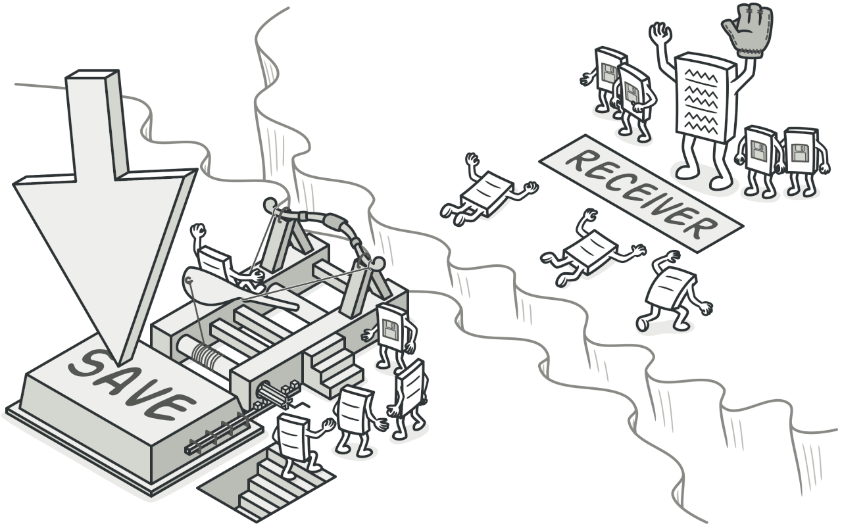

Agenda
What is Command Pattern?
What is MediatR?
What are thin controllers?
How to use MediatR in .NET?
Examples
Q & A
Command Pattern
MediatR library

Slide 3

What is Command Pattern?
The command pattern is a data-driven design pattern that falls in the category of behavior patterns.
Behavioral design patterns are concerned with algorithms and the assignment of responsibilities between objects.

Slide 4
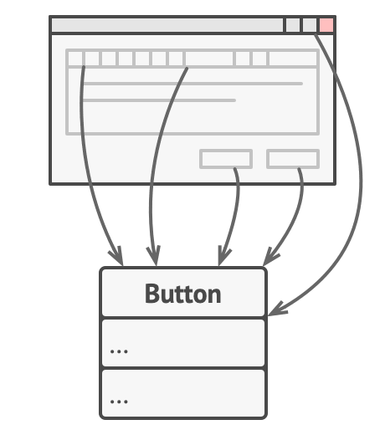
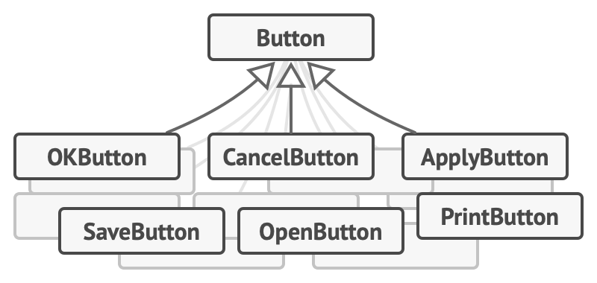
What is the problem?
While all these buttons look similar, they’re all supposed to do different things. Where would you put the code for the various click handlers of these buttons?

Slide 5
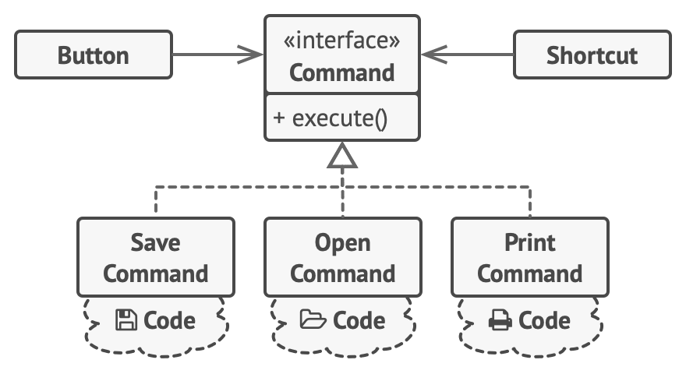
How to solve it?
With the Command pattern, we no longer need all those button subclasses to implement various click behaviors
Solution:
The principle of separation of concerns.
Breaking an app into layers.

Slide 6
Message
Main
Sender
IMessageCommand
EmailMessage Command
SMSMessage Command

Slide 7
The classes and objects participating in this pattern include:
Command (Message)
Declares an interface for executing an operation
ConcreteCommand (EmailMessageCommand/SmsMessageCommand)
Defines a binding between a Receiver object and an action, implements the execution
Client (Main)
Creates a ConcreteCommand object and sets its receiver
Invoker (Sender)
Asks the command to carry out the request
Receiver (Console)
Business logic execution

Slide 8

Demo

Slide 9
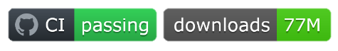
What is MediatR?
Nuget package
Low-ambition library trying to solve a simple problem — decoupling the in-process sending of messages from handling messages. Cross-platform, supporting
Supports request/response, commands, queries, notifications and events, synchronous and async with intelligent dispatching via C# generic variance.
MediatR

Slide 10
What is MediatR?
Controller
Application
Write DB
GET
POST
Command
Handler
UPDATE
DELETE
Read DB

Slide 11
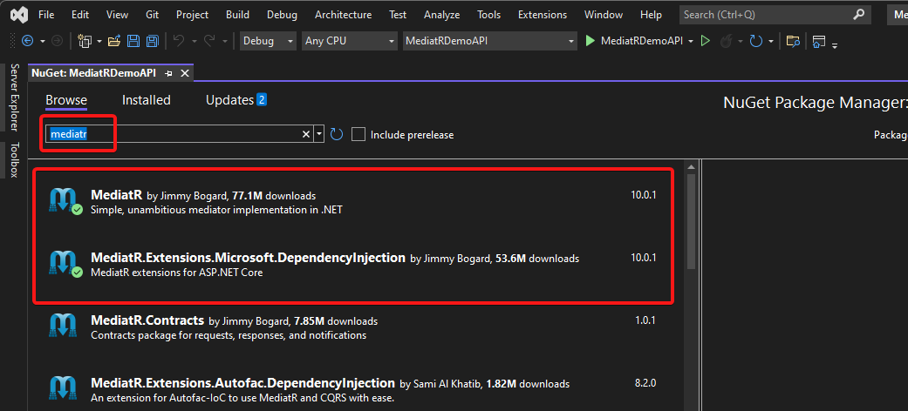
How to use MediatR in .NET?
How to install

Slide 12
How to use MediatR in .NET?
To use MediatR in .NET6, in program.cs class
var builder = WebApplication.CreateBuilder(args);
builder.Services.AddMediatR(Assembly.GetExecutingAssembly());
Wiki: https://github.com/jbogard/MediatR/wiki

Slide 13
What are thin controllers?
[HttpGet]
public async Task<ValueResponse> Get(ValueRequest request)
{
ValueResponse response = await _mediator.Send(request);
if (response == null)
{
return NotFound();
}
return response;
}

Slide 14
What else?
class ValueRequest:IRequest<ValueResponse>
class ValueResponse
class ValuesRequestHandler:IRequestHandler<ValueRequest, ValueResponse>

Slide 15
Demo

Slide 16
Q & A
Please ask and I will answer ☺

Slide 17



Contacts:
Pavel-Purlantov
purlantov
Онлайн събитие
Creating modern REST APIs using convention over use-case
Александър Милушев
11.10.2022
Български

